Slide 1
Project Demo
By Sally Kim (Intern)

Slide 2
Tasks
1st Week
Improve Robot Test Email Template Design (2-3 days)
2nd – 3rd Week
Parse XML file into JSON (4 days)
Data migration to MongoDB (6 days)
4th – 5th Week
Develop Analysis Report & Plotting graphs (10 days)
6th Week
Final Review and Changes (3 days)
*Key: (duration)

Slide 3
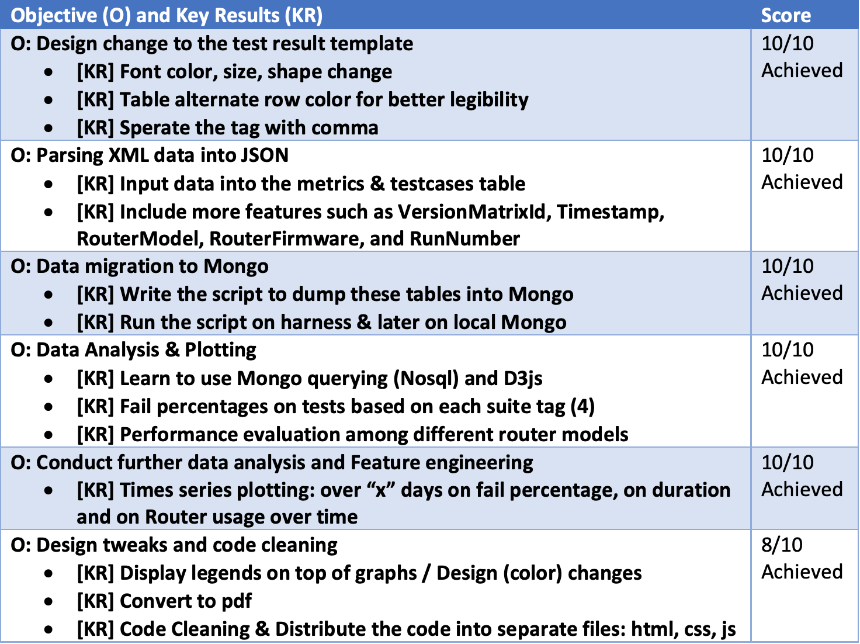
OKR

Slide 4
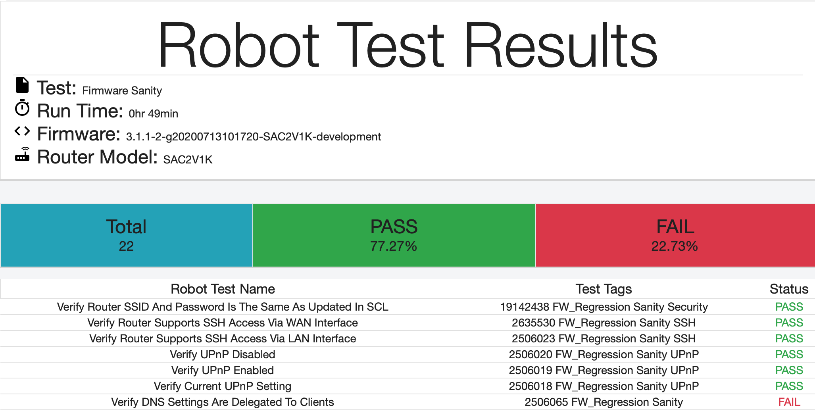
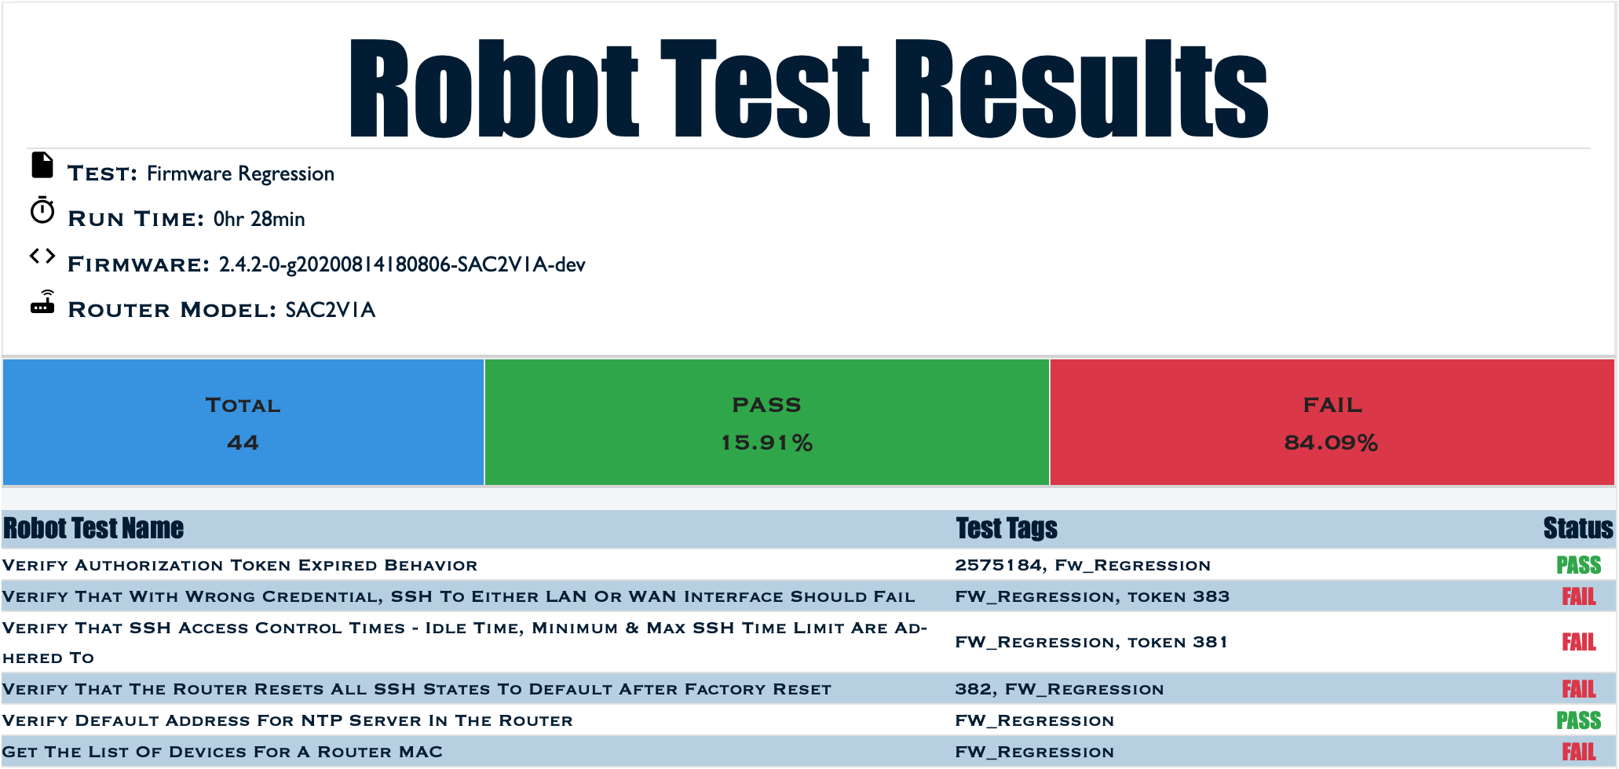
Improve Robot Test Email Template Design

Slide 5


Data migration to MongoDB
Parse XML file into JSON file

Slide 6
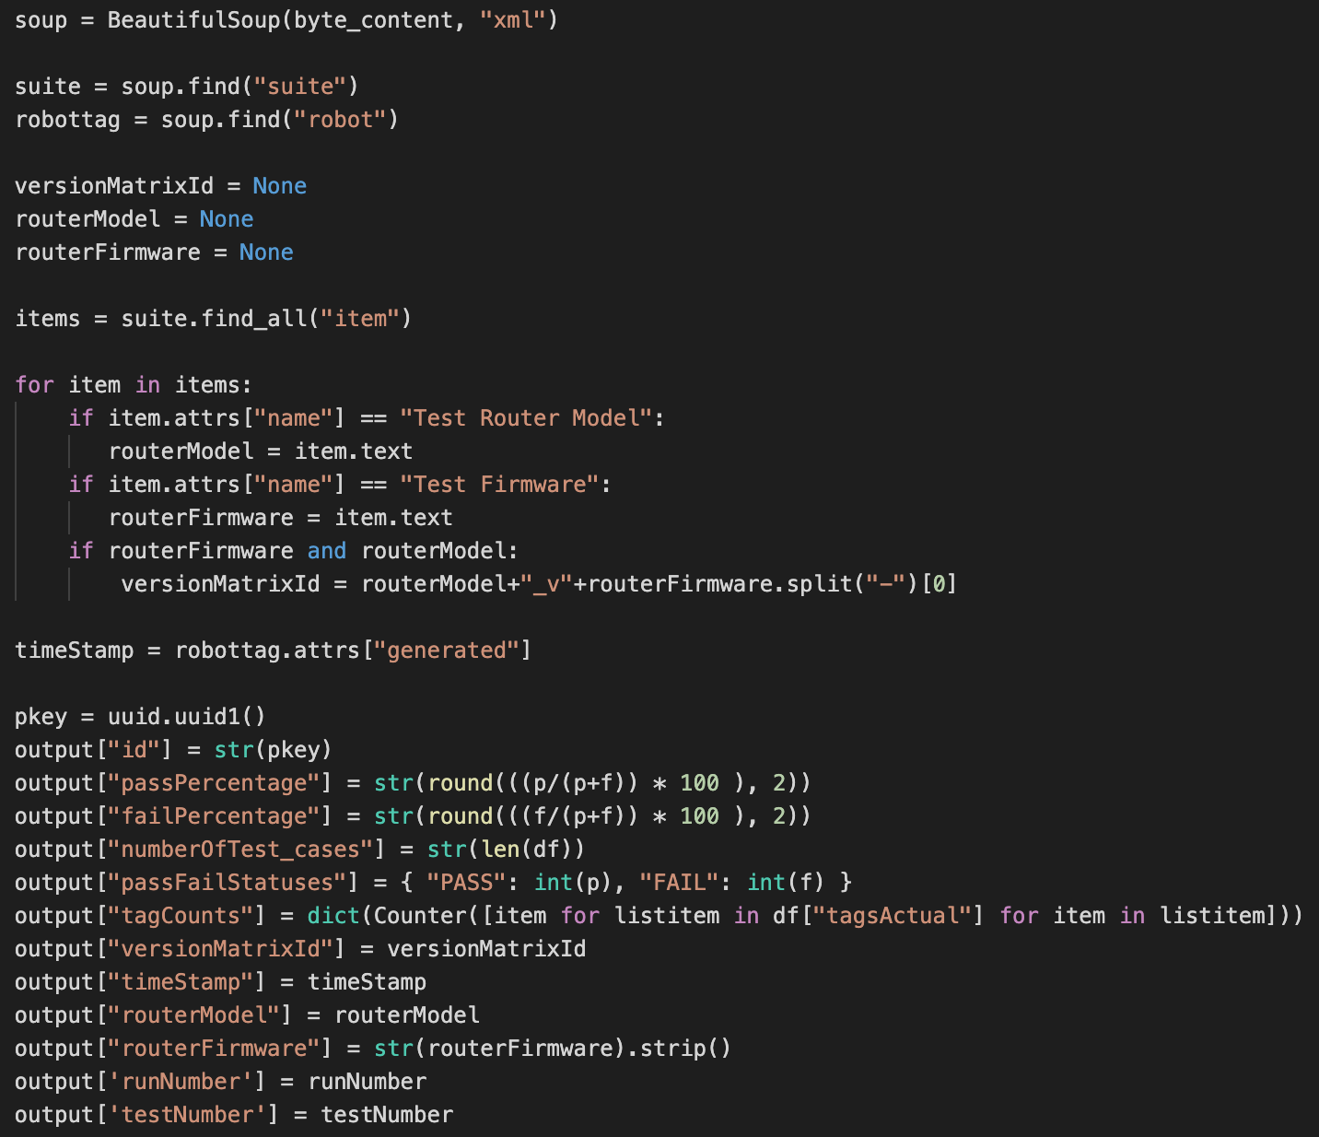
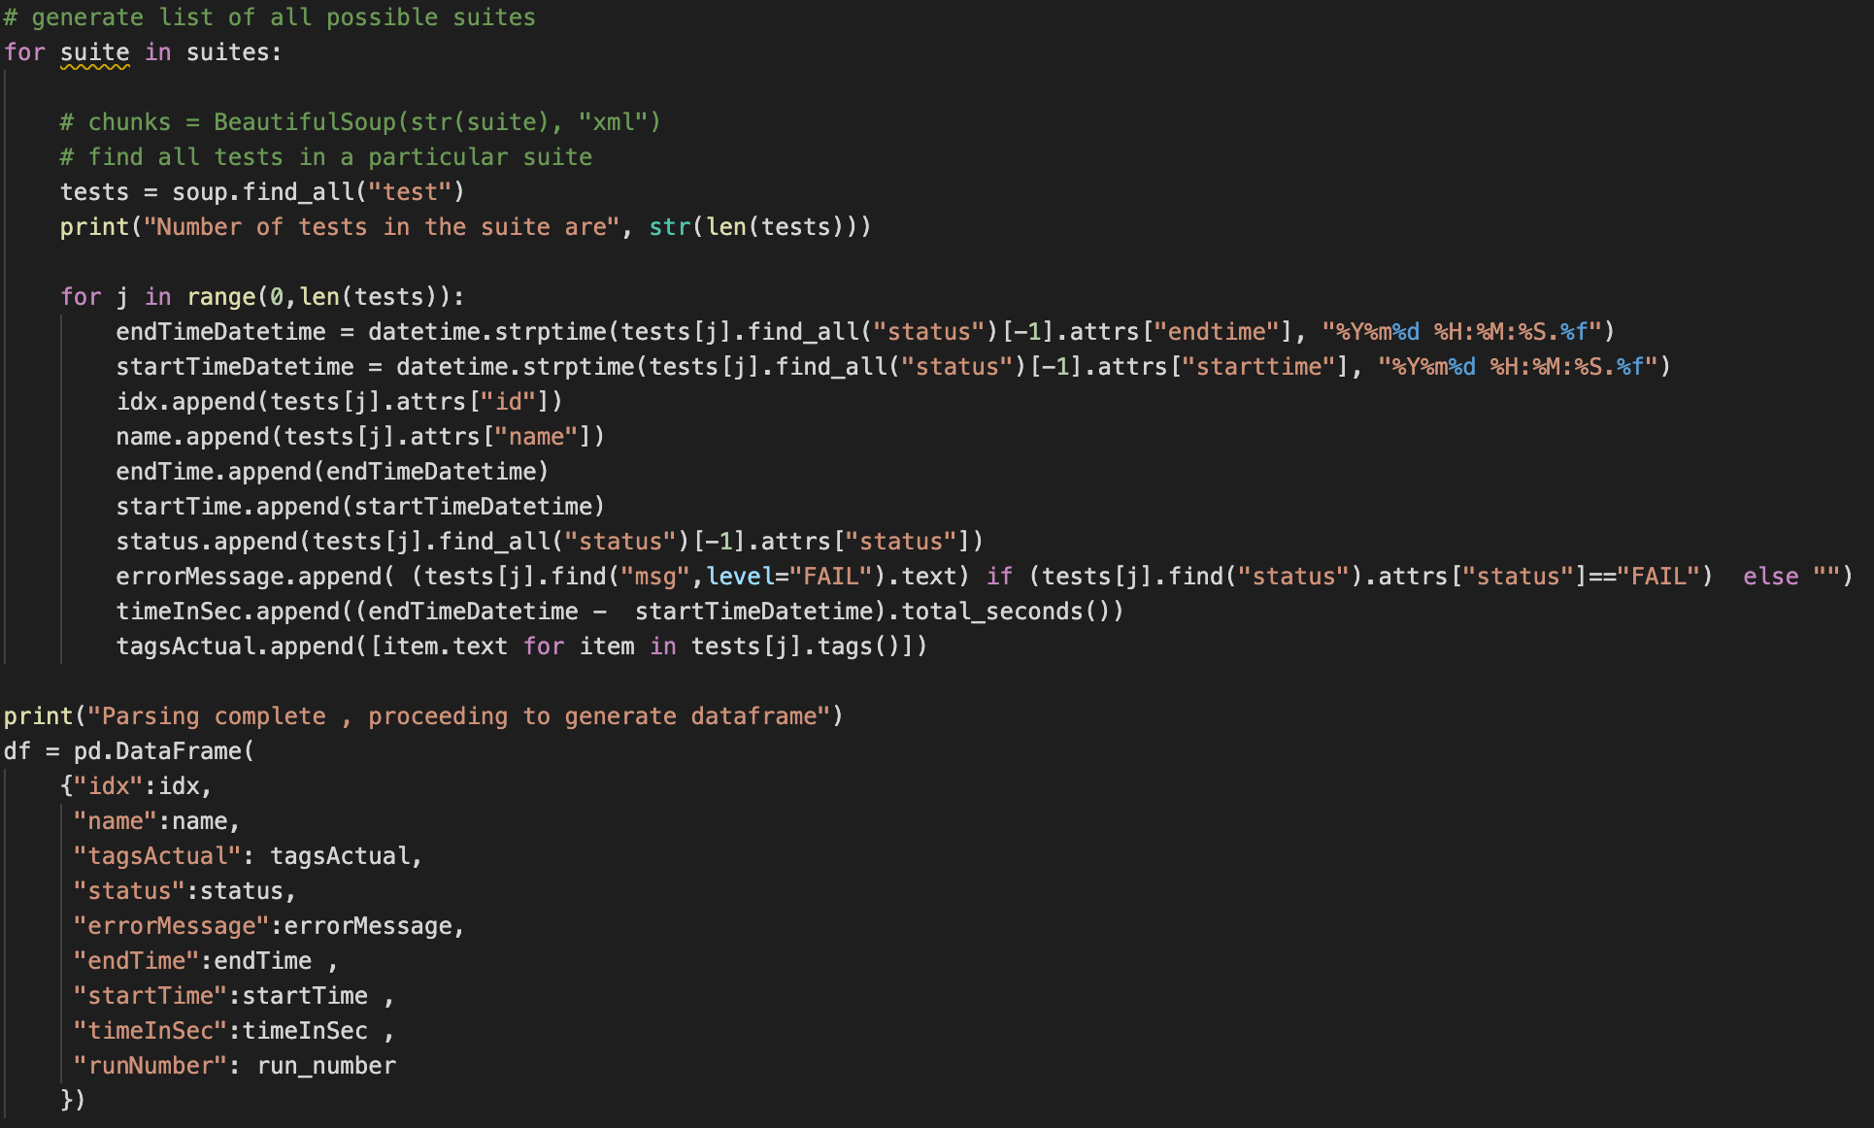
Parse XML file into JSON file
Data into two tables: Metrics & Testcases

Slide 7
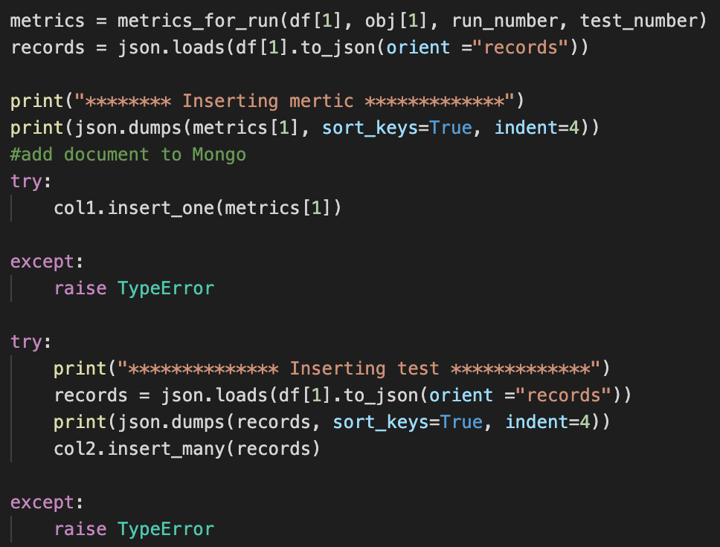

Data migration to MongoDB
Dump JSON data into Mongo

Slide 8
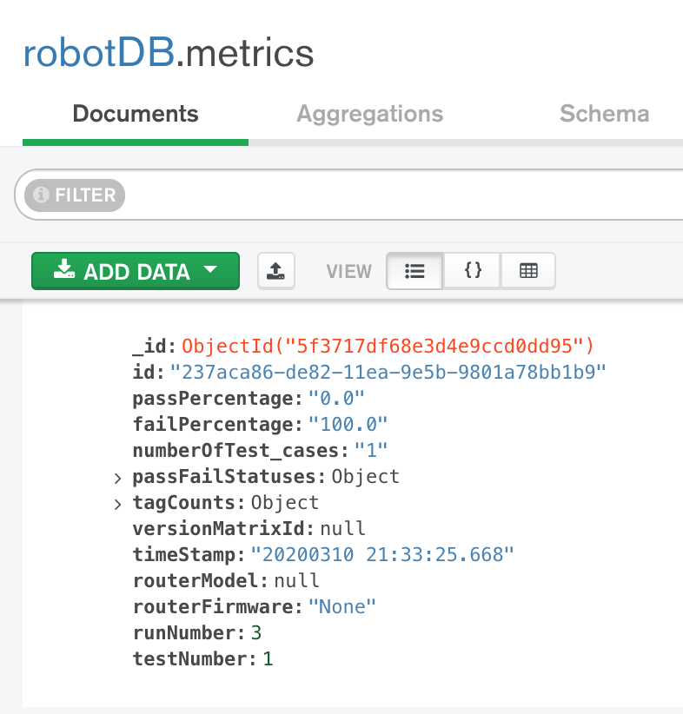
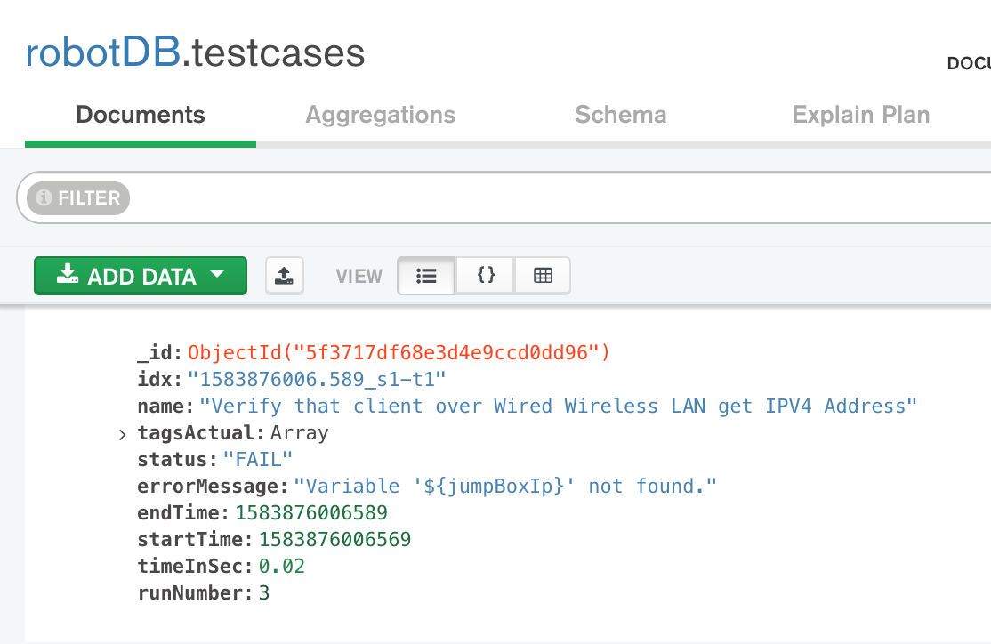
Dump JSON data into Mongo

Slide 9
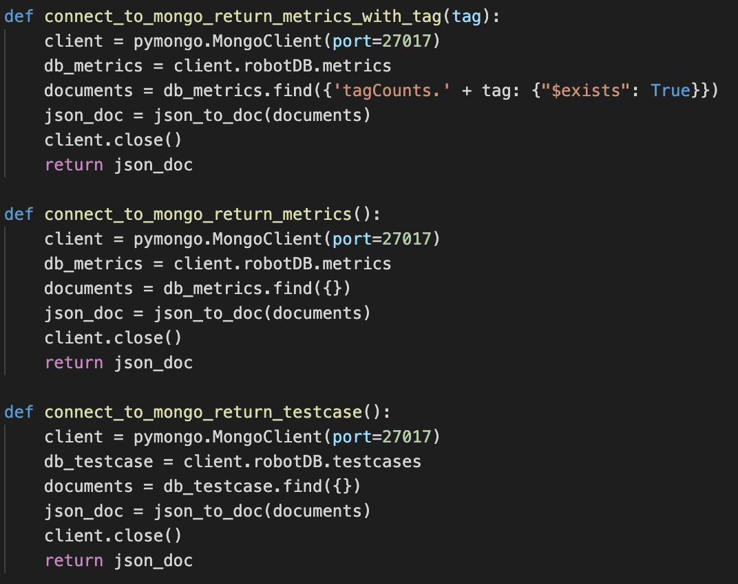
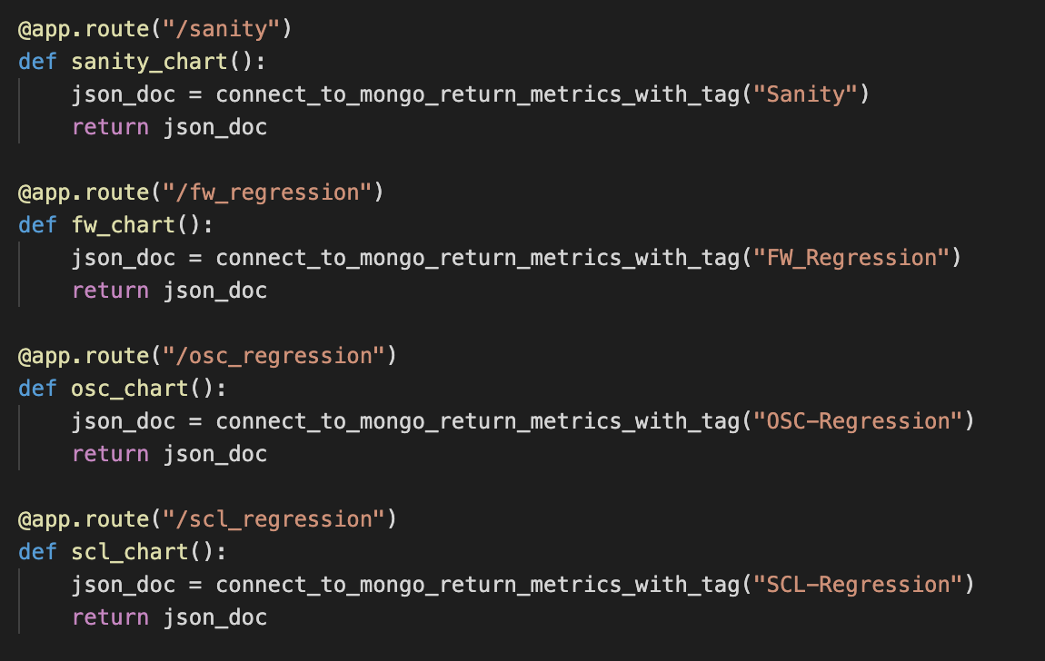
Develop Analysis Report
Mongo to D3.js using flask
Querying out documents from Mongo
Documents ready to be used in D3.js

Slide 10
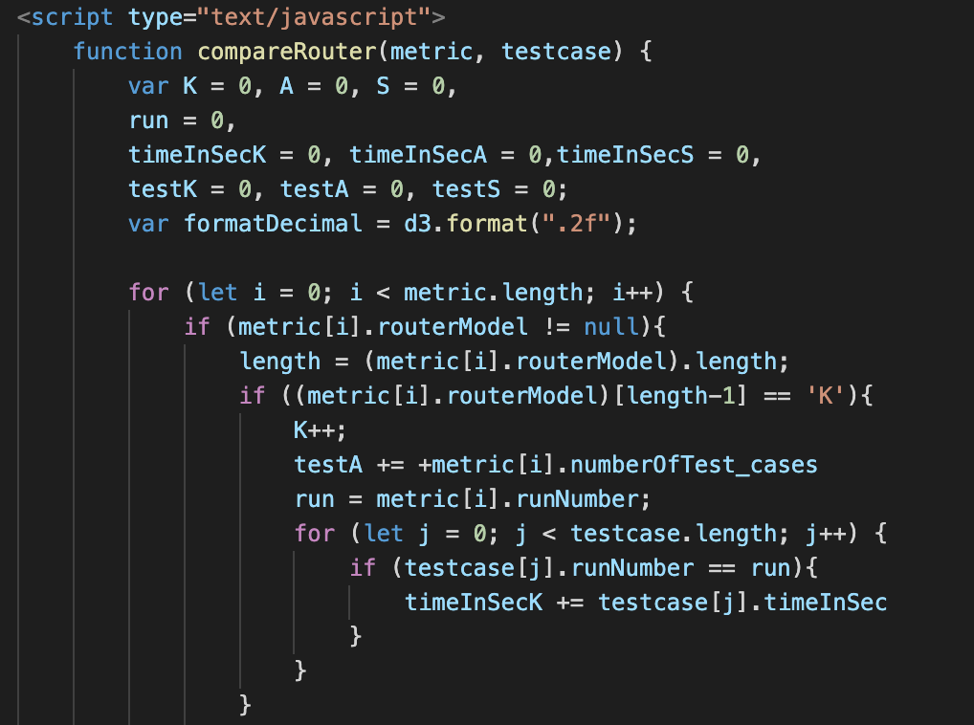
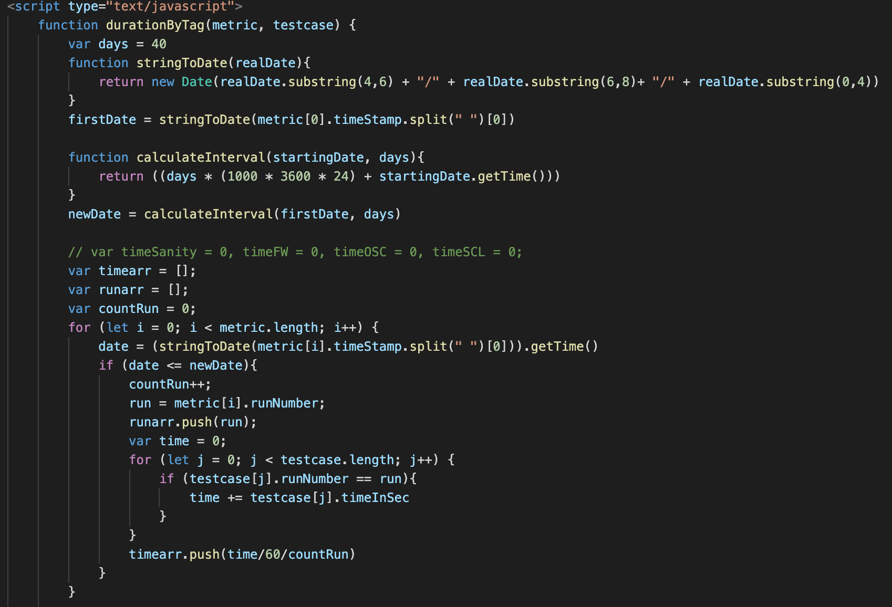
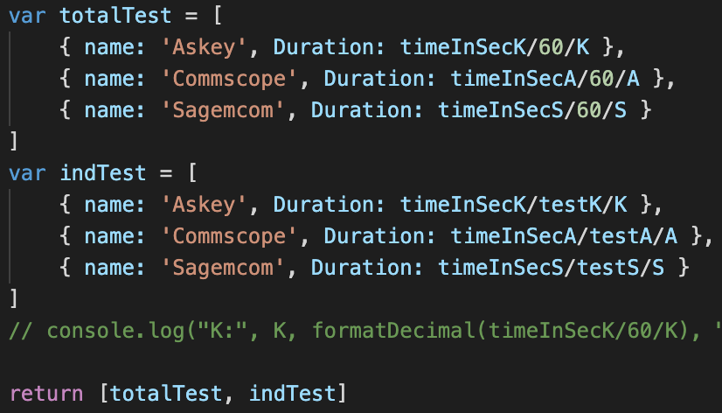
Develop Analysis Report
Feature engineering on router and duration
Feature engineering on times series data
using Dimple.js

Slide 11
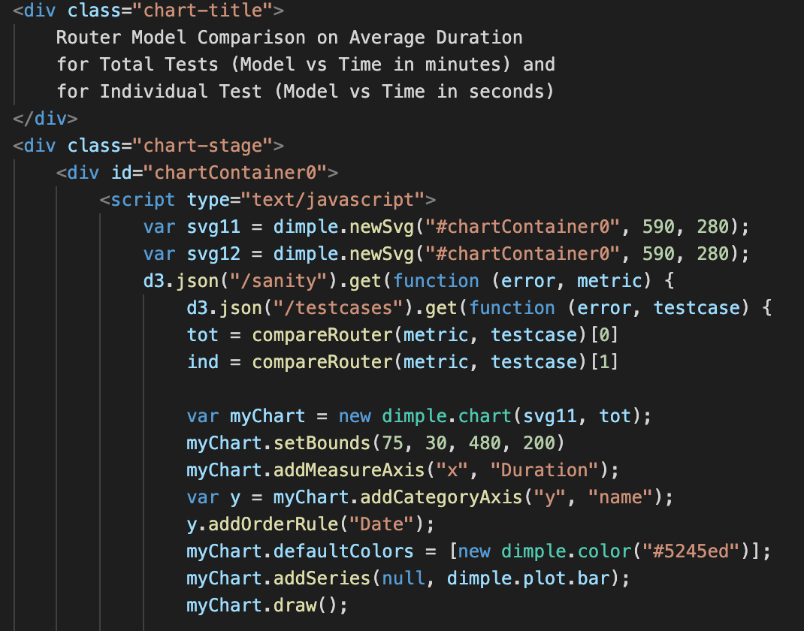
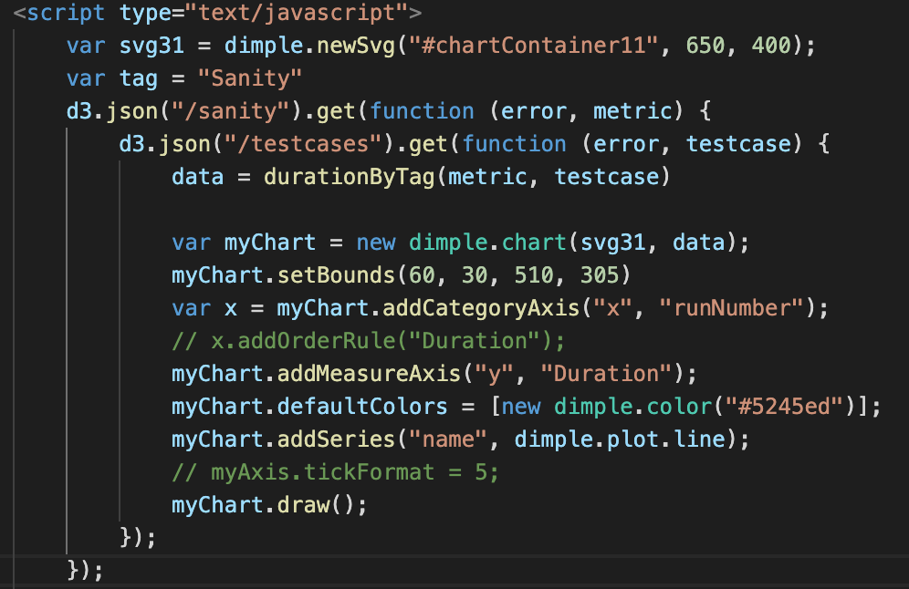
Develop Analysis Report
Plot graphs using Dimple.js
durationByTag()
compareRouter()

Slide 12
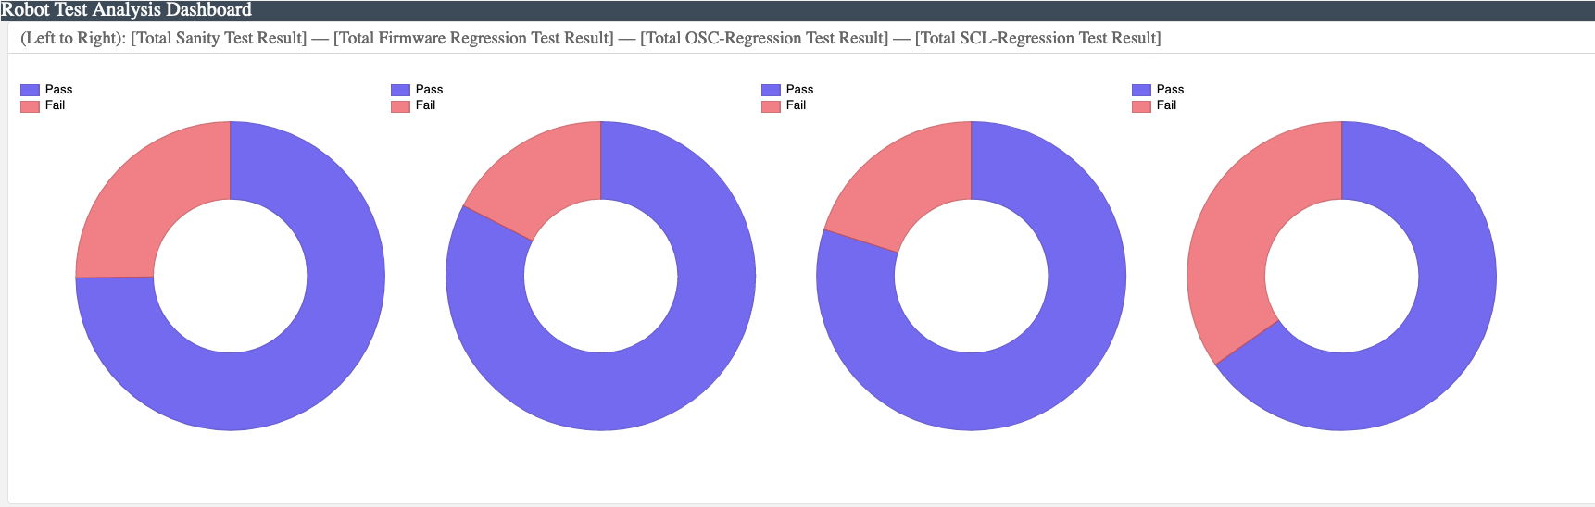
Final Results
Quick look on PASS/FAIL percentage on total tests by suite tag
Sanity Firmware Regression OSC-Regression SCL-Regression

Slide 13
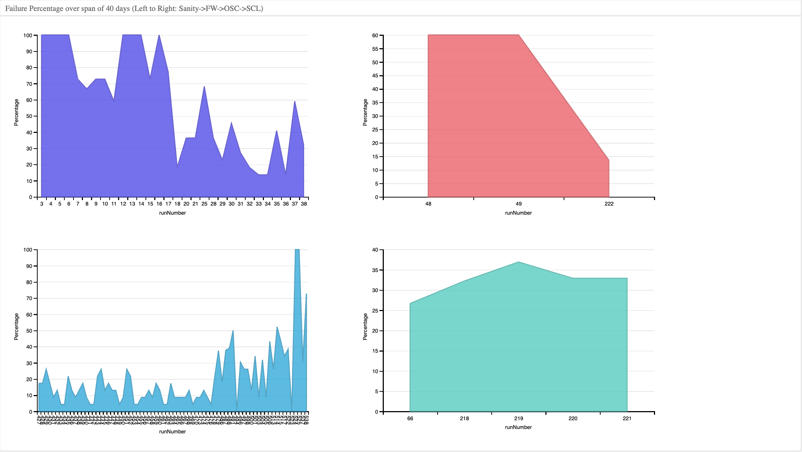
Final Results
Average Fail % in a test in each suite tag during “40” days

Slide 14
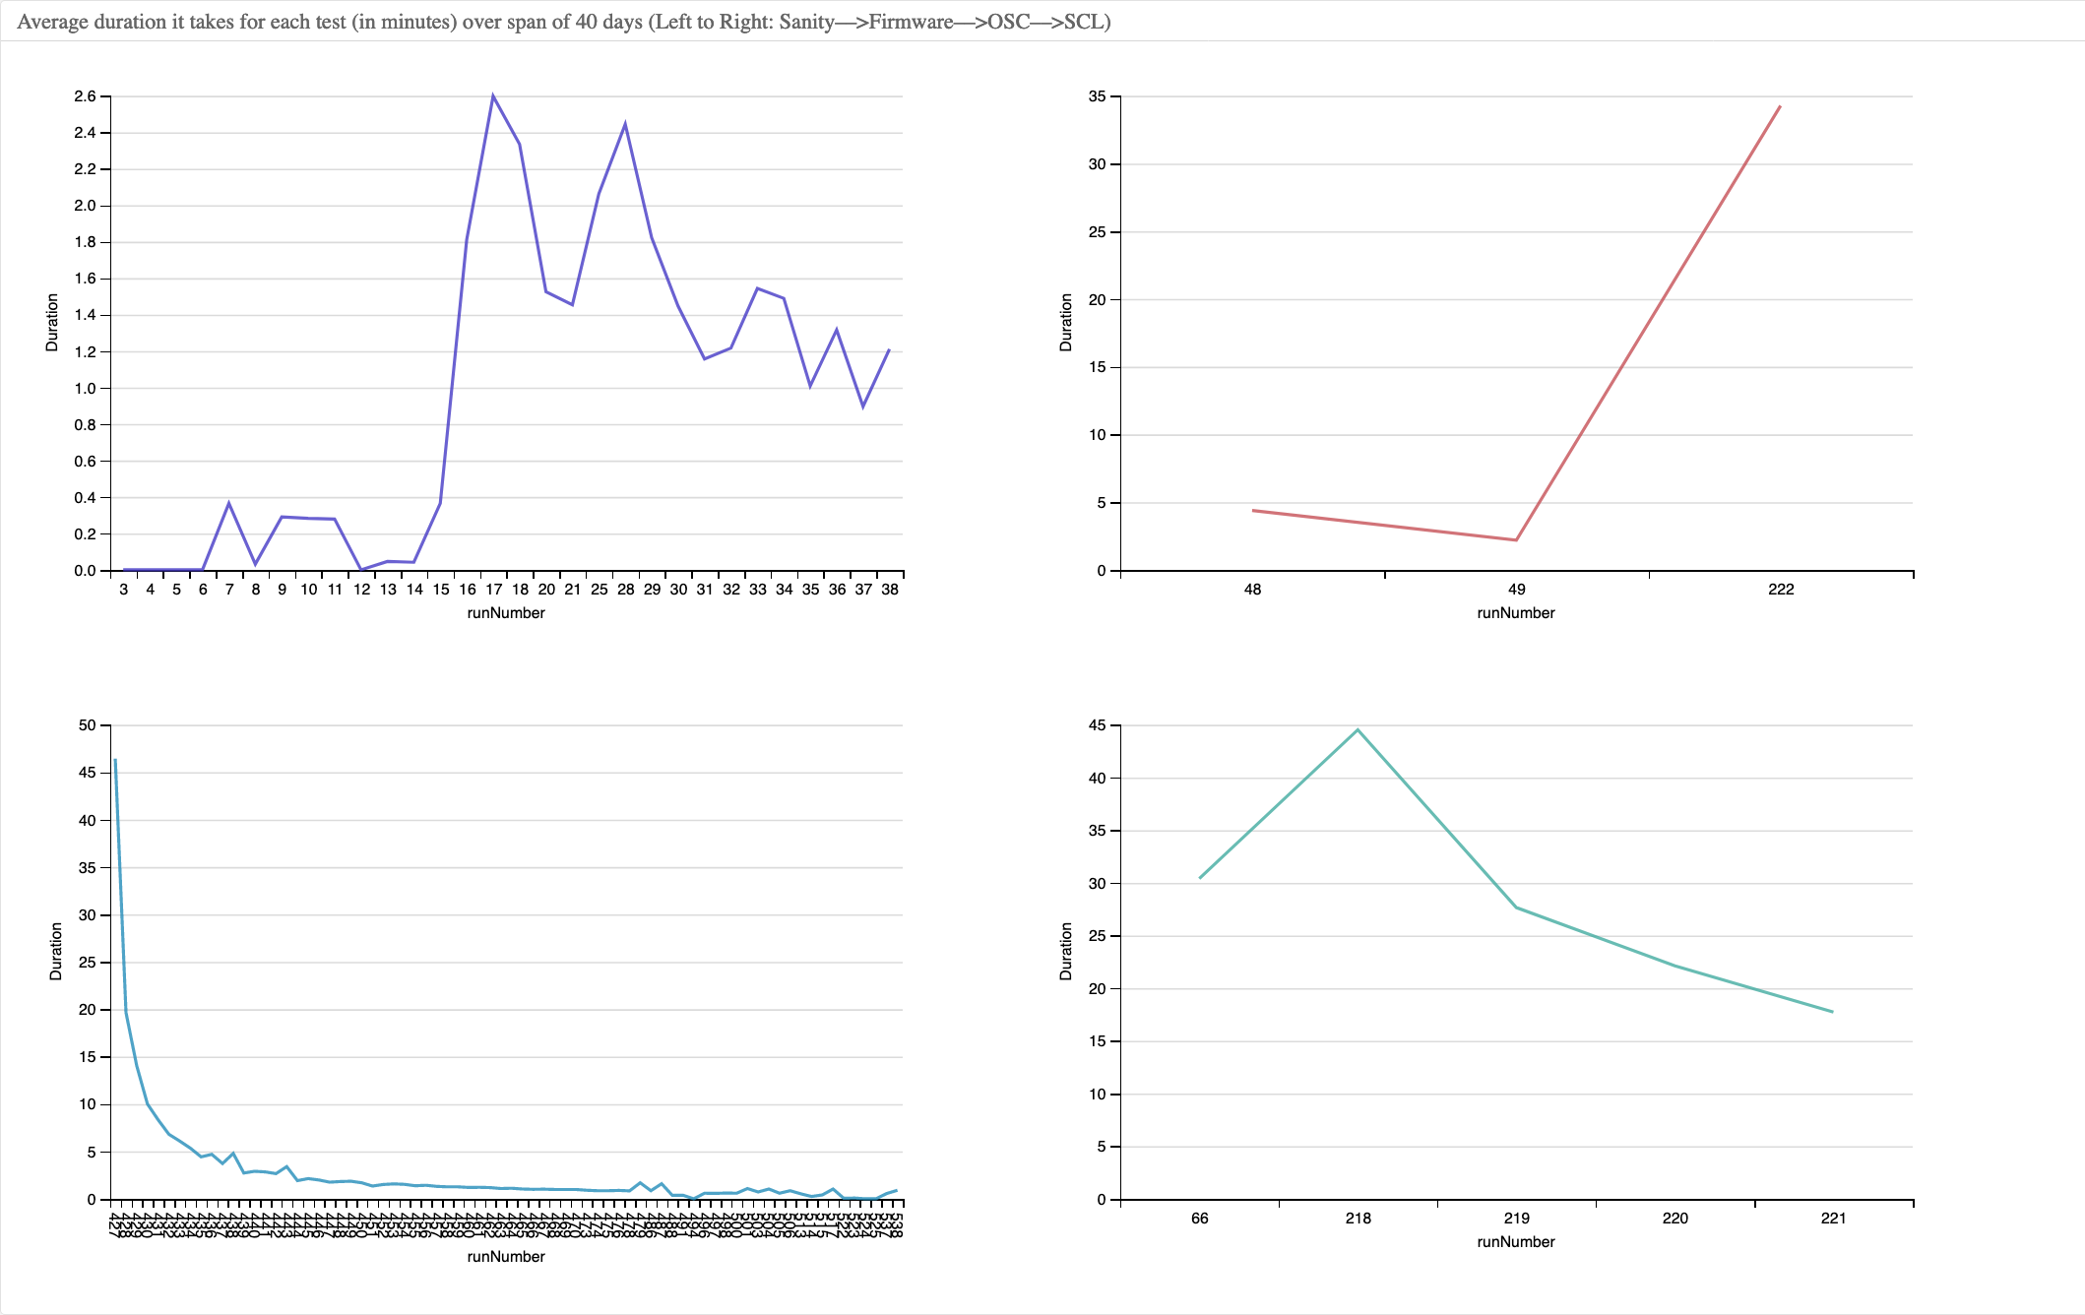
Final Results
Average time it takes for running a test in each tag over the span of “40” days

Slide 15
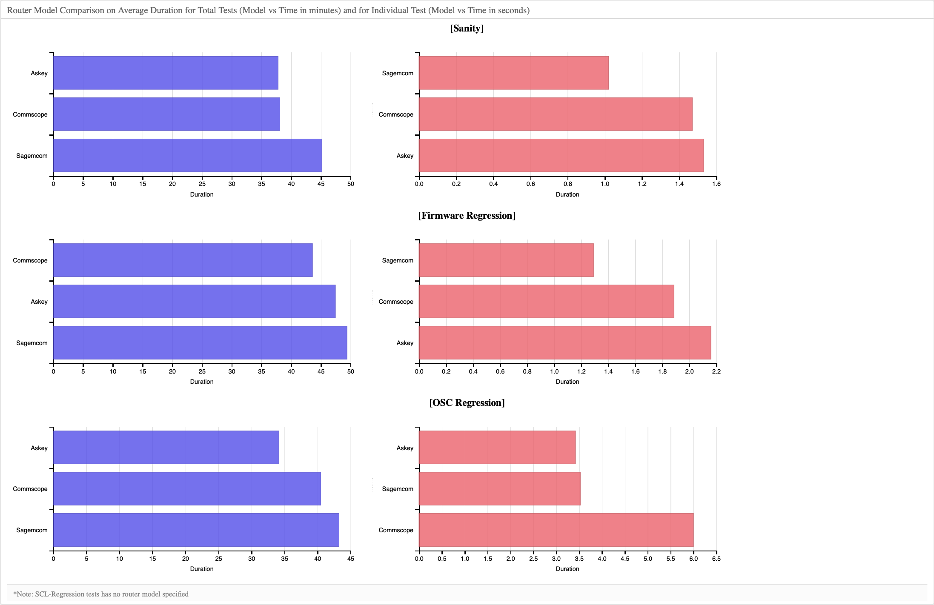
Final Results
Average time it takes for each router to run tests by each suite tag

Slide 16
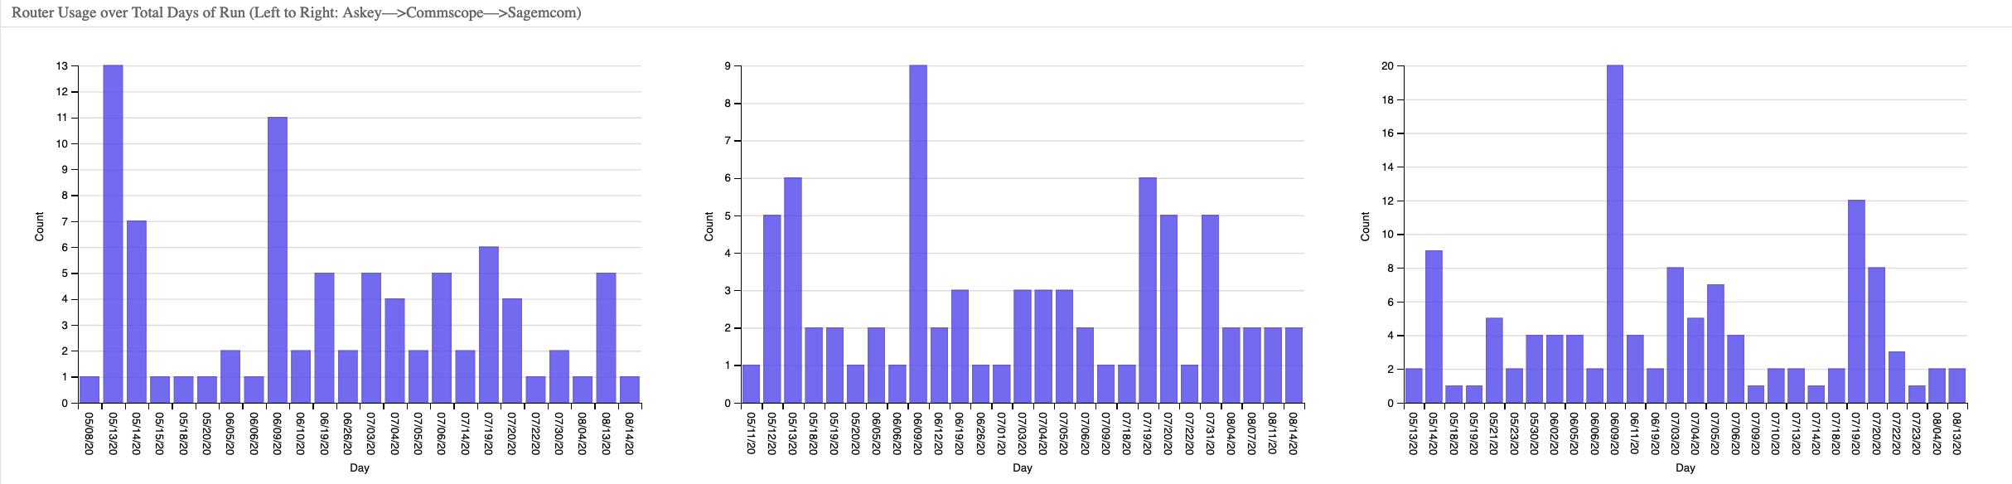
Final Results
Router usage over total days
Askey Commscope Sagemcom

Slide 17
Conclusion
In terms of…
Pass/Fail in Total Test
Firmware (17%) and OSC Regression (20%) have met the requirement
Sanity (25%) and SCL Regression (35%) did not pass the condition
Failure over time
Sanity: decrease from about 50% to 25% at the beginning of June until July
Firmware: steady at 20% but keeps increasing since late July
OSC: steady at 20% but keeps increasing since late July
SCL: steady at 40% throughout
Average duration per test
Sanity: never went above 2.6 min, now steady at below 1 min
Firmware, OSC, and SCL Regressions: dropped significantly to 1 min and below
Router Performance on duration per test
Sanity: Sagemcomm best (1 min), Askey worst (1.5 min)
Firmware: Sagemcomm best (1.3 min), Askey worst (2.2 min)
OSC: Askey best (3.4 min), Commscope worst (6 min)
SCL: Not available

Slide 18
What I’ve learned through the Internship
Communication and time management skills
Problem solving/approaching skills
Software tools: AWS, Data Pipeline, NoSql, Javascript, D3.js

Slide 19
Special Thanks to..
Charter Communications for providing this space for me to grow and gain industrial experience
John Powell for opening this spot and opportunity for me to get a step closer of becoming a software engineer
My Manager Kal, & Mentor Zach and Saurabh for walking me through all the big and tiny steps and teaching me with patience and kindness!

